Slide 1


REALTIME PLANT LEAF DISEASE CLASSIFICATION WITH OPENCV
DSA0216-COMPUTER VISION WITH OPEN CV FOR MODERN AI
GUIDED BY:
Dr. Senthilvadivu S
Dr. Kumaragurubaran T
Presented by:
CH.SRAVYA(192424372)
S.YASO PRIYA(192424394)

Slide 2
Introduction
Overview of the Project:
A real-time system using OpenCV and AI to classify plant leaf diseases from images.
Processes input images through preprocessing, feature extraction, and CNN-based classification.
Provides instant audio feedback to users (e.g., farmers) for actionable results.
Problem Statement:
Manual disease detection is slow, expensive, and requires expertise, limiting accessibility for farmers.
Late diagnosis leads to significant crop loss, impacting food security and farmer livelihoods.
Existing solutions lack real-time, low-cost, and user-friendly (e.g., non-technical) interfaces.
Purpose of the Project:
Automate early disease detection to minimize crop losses and boost agricultural productivity.
Democratize access via a simple, cost-effective tool with audio-based results for farmers.

Slide 3
Problem Statement
Crop Losses Due to Diseases:
Plant diseases such as Brown Spot, Leaf Blast, and Leaf Smut significantly reduce crop yield, directly affecting farmers’ income.
Manual Detection Limitations:
Traditional disease identification is slow, requires expert knowledge, and is prone to errors.
Many diseases have similar visual symptoms, causing misdiagnosis and wrong treatments.
High Cost and Inaccessibility of Laboratory Testing:
Laboratory testing for plant diseases is expensive, time-consuming, and impractical for small-scale farmers.

Slide 4
Objectives
To build a system that can detect plant leaf diseases automatically.
To make the system fast and accurate in real-time.
To reduce the time taken for disease identification.
To provide voice output so farmers can easily understand the results.
To make the system work on mobile or low-cost devices.

Slide 5
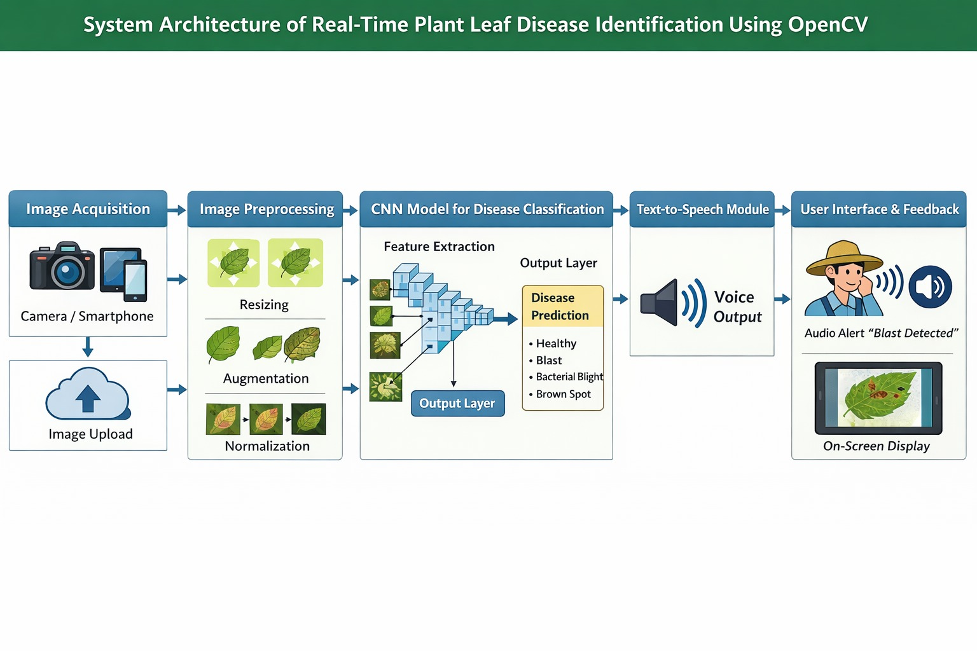
System Architecture

Slide 6
Literature Review
Year | Author(s) | Title | Method Used | Dataset | Accuracy | Limitations
2023 | Sharma et al. | Deep Learning Based Paddy Disease Detection | CNN (Convolutional Neural Network) | Kaggle Paddy Leaf Dataset | 92% | Limited to image upload only, no real-time detection
2023 | Reddy & Kumar | Rice Leaf Disease Classification Using Transfer Learning | MobileNetV2 | Custom Field Images | 94% | No multilingual support
2024 | Singh et al. | Real-Time Crop Disease Detection Using AI | CNN + OpenCV | Field-collected dataset | 95% | No audio explanation for farmers
2024 | Priya & Manikandan | Smart Agriculture Using Deep Learning | ResNet50 | Rice Plant Village Dataset | 96% | Works only in English
2025 | Zhang et al. | Multilingual AI-Based Crop Monitoring System | CNN + NLP + TTS | Multi-country dataset | 97% | Requires high processing power
2025 | Patel et al. | IoT Enabled Real-Time Paddy Disease Detection | CNN + IoT Sensors | Live Farm Data | 96% | Expensive hardware setup

Slide 7
Module 1: Preprocessing of plant leaf images
Objective:
Prepare raw plant leaf images for accurate disease detection.
Enhance relevant features and reduce noise in images.
Standardize images to make them suitable as input for a CNN model.
Step 1: Image Acquisition
Leaf images can be collected using a camera or a pre-existing dataset.
Images often vary in lighting, angle, and background.
Raw images are usually noisy and inconsistent.
Poor-quality images can reduce model accuracy.
Step 2: Resizing
Resize all images to a fixed dimension (e.g., 224x224 pixels).
Standardization ensures uniform input for CNN and efficient processing

Slide 8
Step 3: Color Conversion:
Convert images to RGB format if not already in RGB.
RGB preserves leaf color patterns, essential for identifying diseases.
Step 4: Noise Removal / Smoothing:
Apply Gaussian Blur or Median Filtering.
Removes unwanted noise like shadows, dirt, or small artifacts.
Helps the model focus on disease patterns rather than random pixels.
Step 5: Contrast Enhancement :
Use Histogram Equalization or similar techniques.
Enhances contrast between diseased spots and healthy areas.
Makes lesions or blight areas more distinguishable.

Slide 9
​Step 6: Normalization​
Scale pixel values to the range 0–1 by dividing by 255.​
Improves training stability and accelerates CNN convergence.​
Step 7: Data Augmentation:
Generate additional images via rotation, flipping, zooming, or shifting.
Prevents overfitting and improves model robustness.

Slide 10
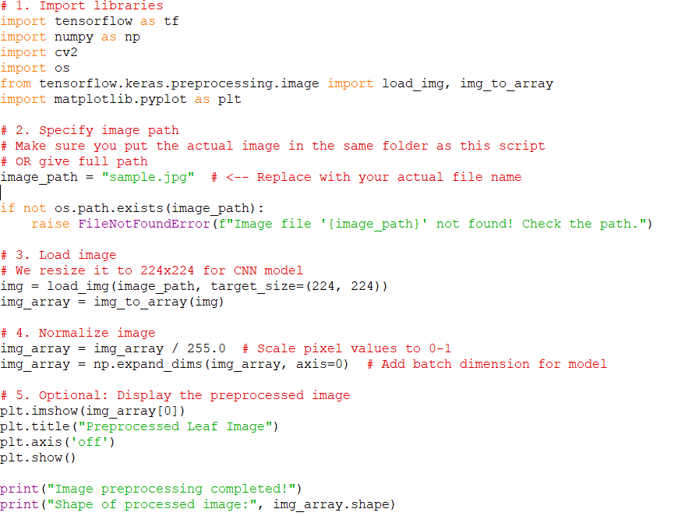
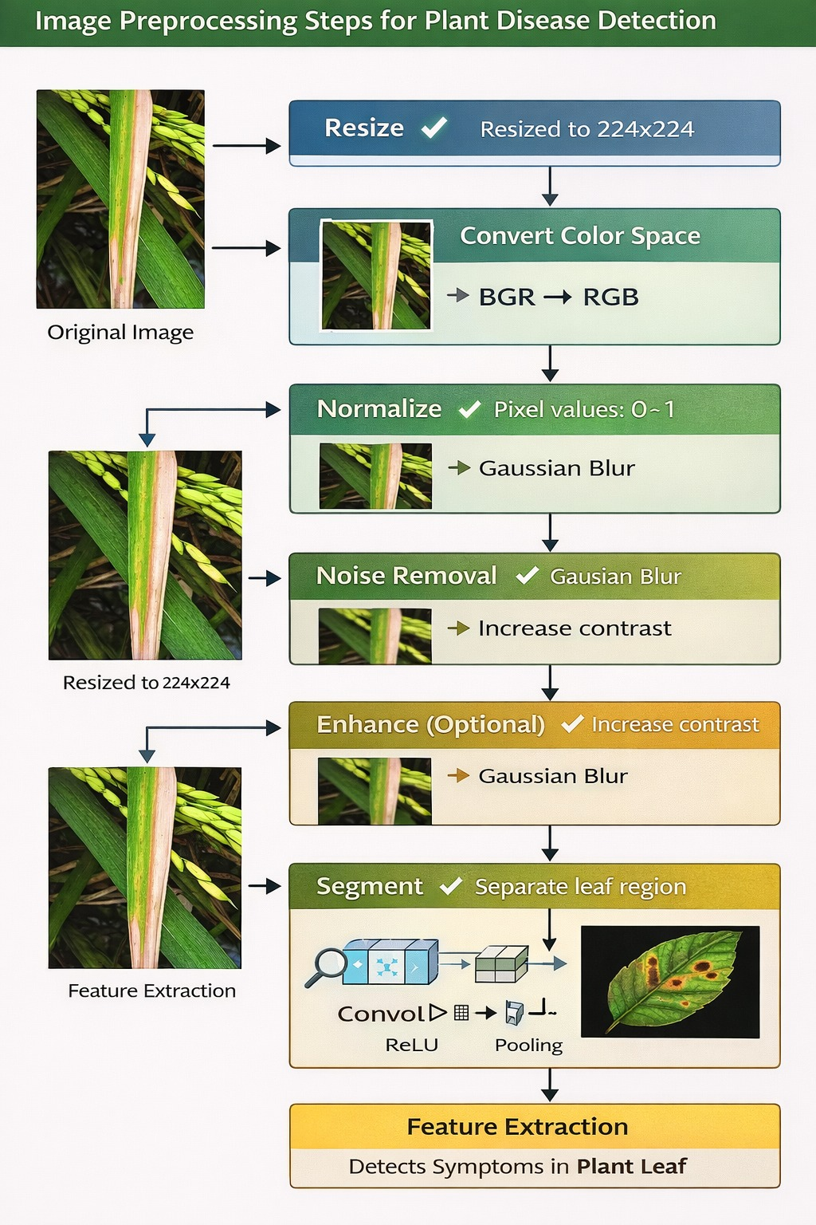
IMPLEMENTATION

Slide 11
Module 2: Disease identification and declaring audio results
Disease Detection with AI Model :
•Process images through a fine-tuned CNN for accurate disease classification
•Generate confidence scores and visual markers (e.g., bounding boxes) for detected symptoms
Multi-Language Audio Alerts :
•Integrate TTS engines (e.g., Google TTS, AWS Polly) for real-time spoken diagnoses
•Support multiple languages for farmers' accessibility with adjustable speech rate
Visual Dashboard Display :
•Show live camera feed with overlaid disease info (class, confidence %, treatment tips)
•Include historical data graphs to track disease progression over time

Slide 12
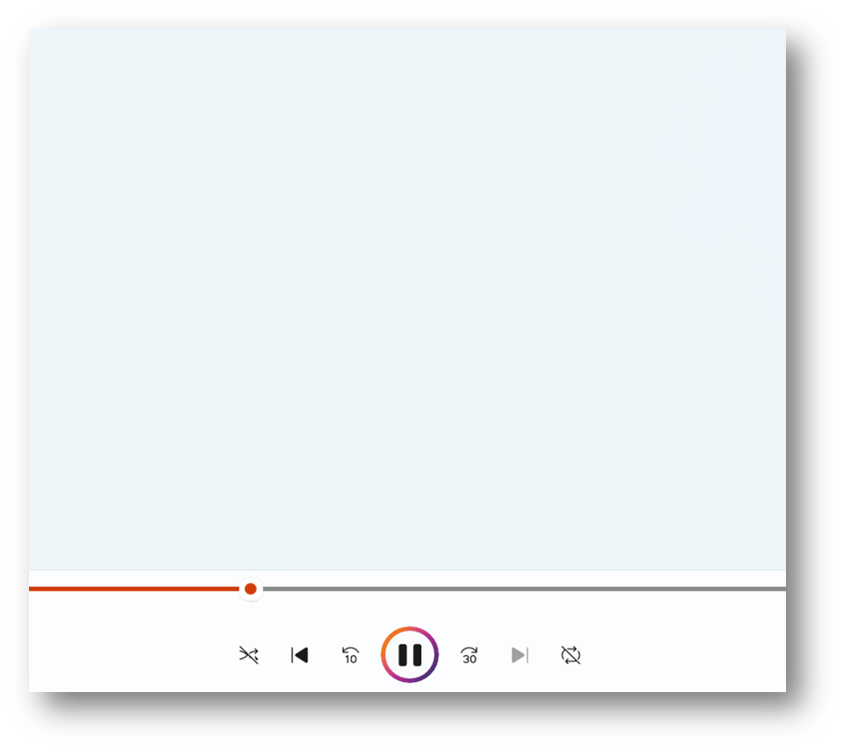
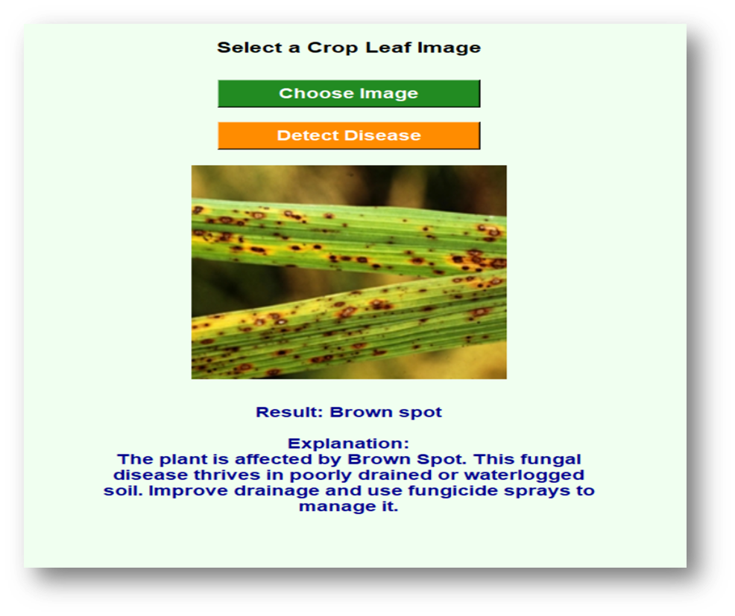
Modules 2 demonstration

Slide 13
Results & Discussion
Effective Disease Identification :
  1)Successfully classified common leaf diseases with consistent reliability.
  2) Minor challenges observed with early-stage or symptom-overlapping cases.
Optimized Edge Performance :
1) The system works efficiently on mobile phones and low cost devices.
2) Gives fast results in real-time without lag.
Practical User Experience :
  Instant audio-visual feedback proved intuitive for farmers.
  Field testing proved the system is simple ,reliable and helpful for farmers.

Slide 14
Challenges & Limitations
Challenges:
Some diseases had very few sample images.
The model became better at detecting common diseases than rare ones.
Code optimization was required to improve speed.
Limitations:
Performance may reduce on low-end smartphones.
Accuracy may slightly decrease on low-power hardware.
Changes in lighting can affect results.
Different leaf angles may reduce detection accuracy.

Slide 15
Conclusion
Developed a real-time plant leaf disease detection system with multi-language support.
Successfully implemented both camera and image upload functionality.
Provided disease name, description, and audio output in native languages for farmer accessibility.
The project enhances farmers’ decision-making and helps prevent crop loss.
Demonstrated integration of AI, computer vision, and web technologies for practical agriculture solutions.
The system is scalable, user-friendly, and adaptable for other crops and languages.
Strengthened technical, problem-solving, and professional skills, preparing for real-world AI deployment in agriculture.

Slide 16
Future Scope
Mobile App Integration – Develop an Android/iOS app with cloud sync for wider accessibility and real-time farmer assistance.
Multilingual Support – Expand audio feedback to regional languages to enhance usability in diverse agricultural regions.
Drone Deployment – Implement the system on agricultural drones for large-scale field monitoring and early disease detection.

